Slide 1
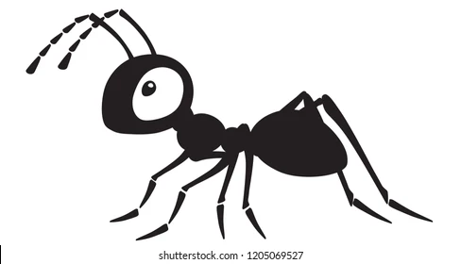
Brood sorting by ants
Ludi van Leeuwen
Corine Nijhof
Advanced Self-Organisation of Social Systems

Slide 2
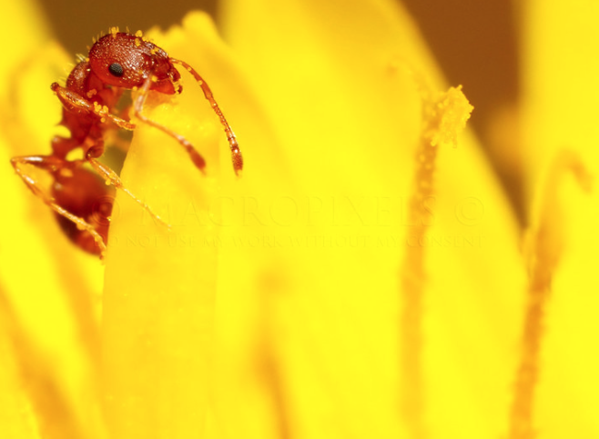
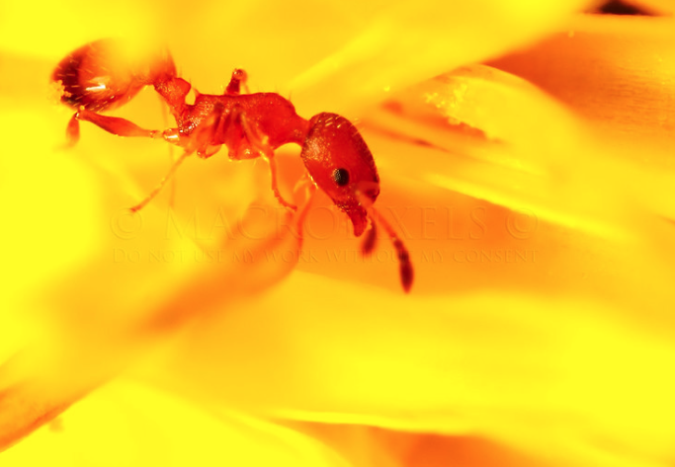
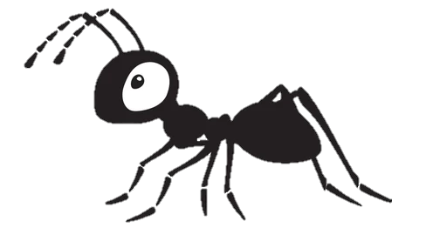
Main character
Notes:
https://www.antkeepers.com/facts/ants/egg-to-ant/

Slide 3
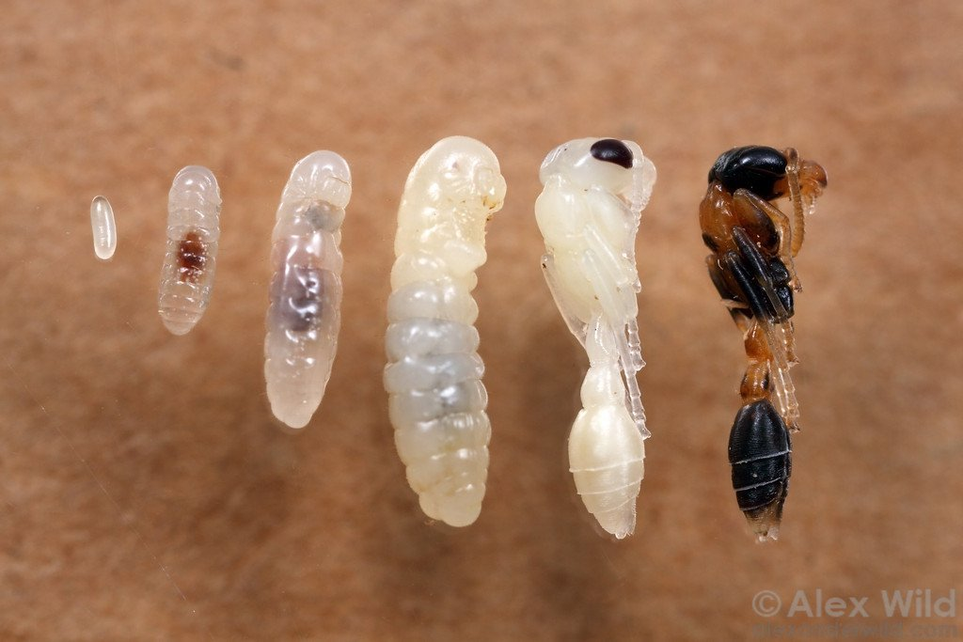
Family picture
Egg
medium
large
pre-pupae
pupae
Notes:
https://www.antkeepers.com/facts/ants/egg-to-ant/

Slide 4
Empirical data (Sendova-Franks 2004)
Brood is sorted in concentric annuli (rings)
Eggs and small larvae
Medium larvae
Large larvae
Prepupae
Pupae
Notes:
https://www.antkeepers.com/facts/ants/egg-to-ant/

Slide 5
Question
What is the cause of this brood organisation?
initial state after migration
brood sorting occurs very fast
pupae
large
prepupae
prepupae
medium
pupae
large
medium
Notes:
https://www.antkeepers.com/facts/ants/egg-to-ant/

Slide 6
Alternative hypotheses
Clustering (Deneubourg, 1991)
pupae
pupae
Caused by: dropping near others of same type.
Clusters, not concentric annuli!
pupae
medium
prepupae
medium
medium
small
large
prepupae
small
small
large
small
large
Notes:
https://www.antkeepers.com/facts/ants/egg-to-ant/

Slide 7
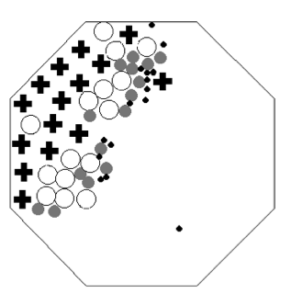
Alternative hypotheses
Muesli effect (Barker & Grimson, 1990)
large
Small items can pass, larger can’t
large
Empirical results (by simulated robots)
large
medium
medium
No concentric annuli!
medium
medium
small
small
small
small
small
small
Wilson (2004)
Notes:
https://www.antkeepers.com/facts/ants/egg-to-ant/

Slide 8
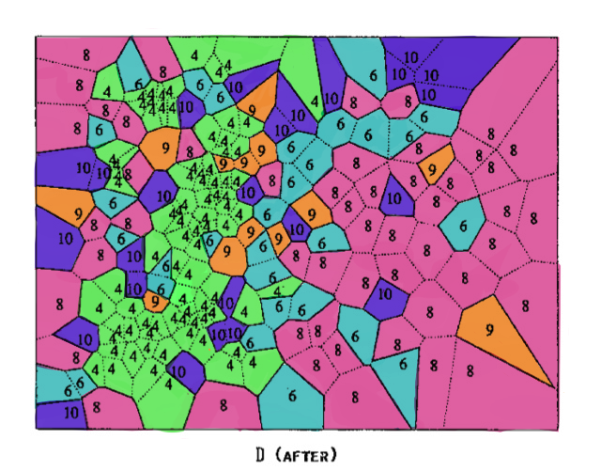
Sendova and Franks Hypothesis
Differential diffusion - each brood type is spaced out according to its domain of care.
Eggs and small larvae
Medium larvae
Large larvae
Prepupae
Pupae
Franks (1992)

Slide 9
Hypothesis
Domain of care ~ to amount of care that brood needs
Eggs and small larvae
Medium larvae
Large larvae
Prepupae
Pupae
Eggs, pupae and prepupae are clustered very close together, medium and large larvae are on the outside, and need more space.

Slide 10
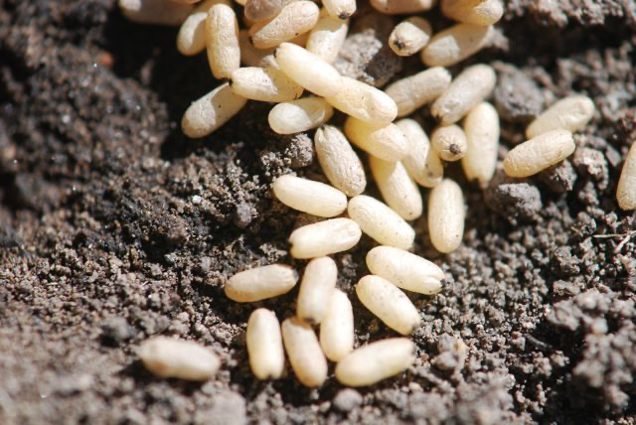

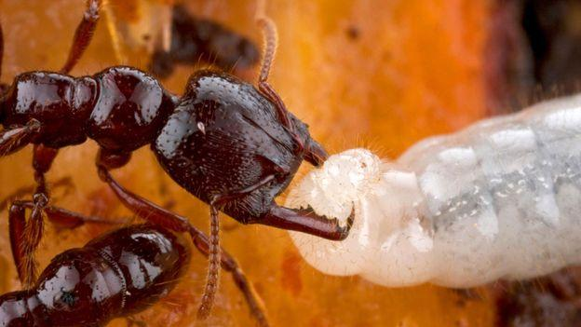
Hypothesis
Domain of care ~ to amount of care that brood needs
Care eggs and larvae: Feeding and cleaning
Care (Pre)-Pupae: No feeding, only cleaning
for illustration purposes only - this is not the right species of ant

Slide 11
Hypothesis
Care ordering: Large larvae > Medium larvae ~ Prepupae ~ Pupae > Small larvae and eggs.
Evolutionary explanation: more energy invested in large larvae, hence need more care.

Slide 12
Hypothesis
Care ordering: Large larvae > Medium larvae ~ Prepupae ~ Pupae > Small larvae and eggs.
Simple rules:
Pick brood up if overcrowded according to domain of care.
Drop brood if not overcrowded anymore.

Slide 13
Hypothesis
Care ordering: Large larvae > Medium larvae ~ Prepupae ~ Pupae > Small larvae and eggs.
Simple rules:
Pick brood up if overcrowded according to domain of care.
Drop brood if not overcrowded anymore.
+ tiredness - ants carry small/light brood easier than large/heavy brood.

Slide 14
Model
Ants
Larvae
Carry
Pick up if not enough room around larva
Drop when enough room or ant too tired
Energy
Vision
Speed
Pick-up range
Max tiredness
Type
Weight
Care domain
Pheromones

Slide 15
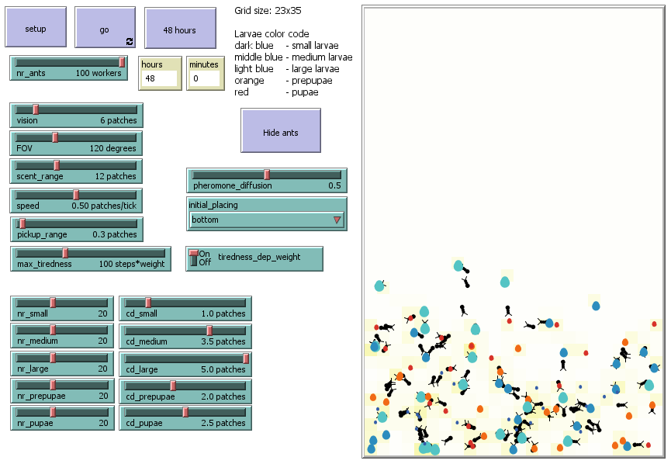
Model demonstration
Notes:
Show model by screensharing

Slide 16

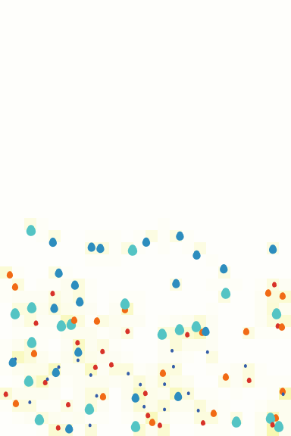

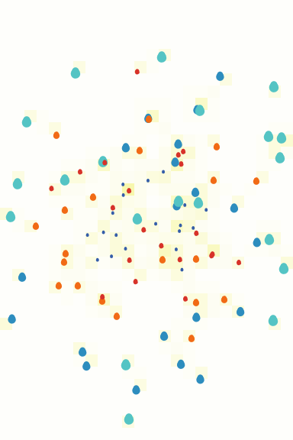
Initial placing bottom vs. center

Slide 17
Initial placing bottom vs. center

Slide 18
Initial placing bottom vs. center

Slide 19
Care domain
proportional to weight vs. equal
Notes:
equal cd = 2.5

Slide 20
Care domain
proportional to weight vs. equal for all larvae
Notes:
equal cd = 2.5

Slide 21
Tiredness
dependent on weight vs. equal for all larvae
Notes:
equal cd = 2.5

Slide 22
Tiredness
dependent on weight vs. equal for all larvae
Notes:
equal cd = 2.5

Slide 23
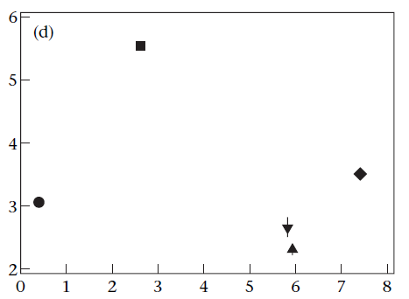
RMS of brood displacement
model vs. empirical (Sendova-Franks, 2004)
Root mean square displacement of brood (mm)
Weight of larvae (length³ mm)
Notes:
absolute values: blue
trend: grey

Slide 24
RMS of brood displacement
model vs. empirical
Root mean square displacement of brood (mm)
Weight of larvae (length³ mm)
Notes:
maximum tiredness = 50

Slide 25
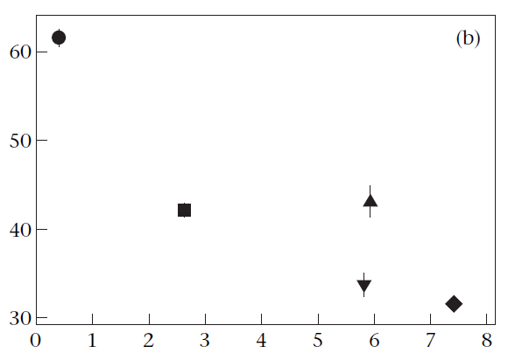
Mean duration of brood movement by ants
model vs. empirical
Mean duration of movement (s)
Weight of larvae (length³ mm)

Slide 26
Mean duration of brood movement by ants
model vs. empirical
Mean duration of movement (s)
Weight of larvae (length³ mm)

Slide 27
Summary table (significance?)
 | Answer | Significant difference
Center vs bottom - does sorting occur? | yes, occurs in both | Nope
Care domain - does it affect sorting? | yes - with equal care domain, smalls are outside! | Yes
Tiredness - does it affect sorting? | yes - if tiredness does not depend on weight, sorting is not as strong (care domain is more relevant) | Probably

Slide 28
Conclusion
Model shows
Different care domains cause brood sorting
Tiredness is less important than care domain in resulting brood sorting
Lighter larvae can be carried longer, but aren’t because of small care domain

Slide 29
Discussion
Model agrees with article on
Larvae with more weight can be carried less far
Larvae with bigger care domain end up more towards periphery
Structure!
Model disagrees with article on
Even though small larvae can be carried further, they aren’t
Probable cause: small larvae are already “happy” where they are due to their small domain of care

Slide 30
Further research
We took “domain of care” as a primitive, but can we get “domain of care” to emerge by modelling food requirement and cleaning requirements directly?
Sendova and Franks discuss 2 different phases: 1 of direct, tight clustering, and 2 of spacing out - we only modelled phase 2 - can we model both phases?

Slide 31
References
Franks, N. R. & Sendova-Franks, A. B. 1992. Brood sorting by ants: distributing the workload over the work-surface. Behavioral Ecology and Sociobiology, 30, 109–123.
Sendova-Franks, A. B. et al. “Brood sorting by ants: two phases and differential diffusion”. Animal Behaviour, 68 (2004): 1095 - 1106. https://doi.org/10.1016/j.anbehav.2004.02.013
Wilson, M. et al. “Algorithms for Building Annular Structures with Minimalist Robots Inspired by Brood Sorting in Ant Colonies.” Autonomous Robots 17 (2004): 115-136.

